Slide 1
유니티 1팀 씬 기획

Slide 2
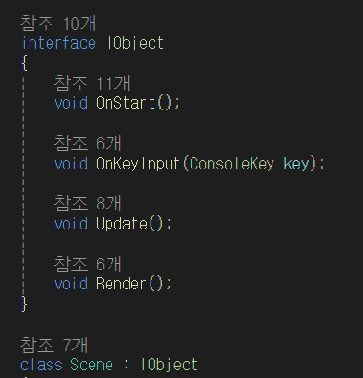
씬 구조 예시

Slide 3
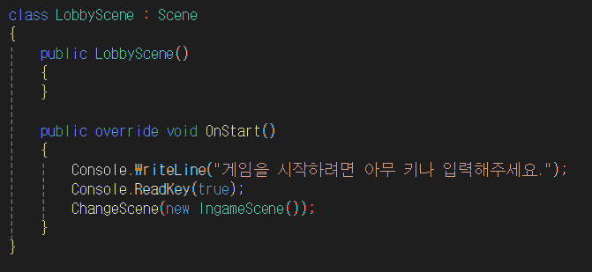
씬 예시

Slide 4
TitleScene
PrologScene
BusanScene
BusanGameScene
BusanStoreScene
BusanInnScene
BusanBattleScene

Slide 5
IncheonScene
IncheonGameScene
IncheonStoreScene
IncheonChatScene
IncheonBattleScene

Slide 6
FinalBattleScene
TrueEndingScene
NormalEndingScene
BadEndingScene
HiddenEndingScene

